Slide 1
Centralized Monitoring System for Street Light Fault Detection and Location Tracking Hardware Smart Automation.
PIP2001 Capstone Project
Final Review
Batch Number : G05
STUDENT NAME | ROLL NUMBER
D VACHAN KUMAR | 20211CIT0058
POOJITHA U | 20211CIT0077
MOHANA KRISHNA RAJU BD | 20211CIT0102
RAKESH R | 20211CIT0149
G VINAY | 20211CIT0107
Under the Supervision of,
Ms. Raesa Raseen Assistant Professor
School of Computer Science and Engineering
Presidency University
Name of the Program: B.Tech CSE(IOT)
Name of the HoD: Dr. S P AnandaRaj
Name of the Program Project Coordinator : Dr. Sharmasth Vali Y
Name of the School Project Coordinators : Dr.Sampath A K / Dr.Abdul Khadar A / Mr.Md Ziaur Rahman

Slide 2
Content
Problem Statement
Github Link
Analysis of Problem Statement
Timeline of the Project
References

Slide 3
Problem Statement Number: 221
Organization: Ministry of Housing and Urban Affairs
Category : Hardware and Software
Problem Description Electricity is the critical need for progress of the livelihood many Indian cities, the maintenance of street lights has become a challenging and inefficient process due to the lack of a centralized monitoring system. Identifying faults, such as non- functioning lights, current leakage and cable breakage, relies on citizen grievances, leading to delays, increased costs, and safety concerns. Linemen spend valuable time manually searching for faults, diagnosing issues, and fixing them, which can take several days to complete. The absence of precise fault location information further complicates the process. To overcome these obstacles, we seek an innovative solution that provides real-time fault detection, accurate identification of fault types, and precise location tracking of faulty street lights. This solution aims to empower linemen with efficient fault management capabilities, reducing their workload and ensuring timely maintenance. Moreover, it should enable the local authorities to proactively address faults, enhance service quality, and optimize street light maintenance processes in their respective cities. The prime aim of this problem statement is to develop a "Automated Defect Detection and Prevention Assistance with Effective Governance for Cities in India“
Difficulty Level: Complex

Slide 4
Github Link
https://github.com/VachanKumar11/Street-Light-Monitoring-System-

Slide 5
Analysis of Problem Statement
Inefficient Fault Detection: Street light maintenance relies on citizen complaints, causing delays and inefficiencies.
High Operational Costs: Manual fault detection increases labor costs and prolongs repair times.
Safety and Security Risks: Non-functioning streetlights lead to accidents, crime, and public inconvenience.
Lack of Real-time Monitoring: Authorities struggle with tracking faults and optimizing maintenance schedules.
Absence of Precise Location Data: Linemen waste time searching for faulty streetlights without exact fault locations.

Slide 6
Analysis of Problem Statement
Hardware
Software
ESP32 Microcontroller
Light Sensor (LDR)
Current Sensor (ACS712)
Voltage Sensor (ZMPT101B)
Relay Module
GPS Module (Neo-6M)
GSM/LTE Module (SIM800/900)
Wi-Fi/Bluetooth Connectivity
Power Supply (5V/12V)
Embedded C(Arduino IDE or ESP-IDF)
Micro Python (Optional)
MQTT Protocol Google Maps API / OpenStreetMap

Slide 7
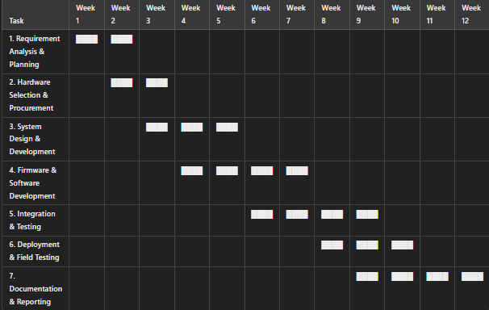
Timeline of the Project (Gantt Chart)

Slide 8
References (IEEE Paper format)
Books
Monk, S. (2017). Programming Arduino: Getting started with sketches (2nd ed.). McGraw-Hill Education. Margolis, M. (2020). Arduino cookbook (3rd ed.). O’Reilly Media.
Journal Articles
Smith, J., & Doe, A. (2022). Smart city IoT applications: A case study on streetlight automation. International Journal of Smart Technology, 15(3), 45-60. https://doi.org/xxxxx
Conference Papers
Brown, K., & Wilson, T. (2021). Implementation of IoT-based real-time fault detection in streetlights. In Proceedings of the IEEE Smart Cities Conference (pp. 120-130). IEEE.
Technical Documentation
Espressif Systems. (2023). ESP32 technical reference manual (Rev 4.0). Retrieved from https://www.espressif.com/en/products/socs/esp32/resources

Slide 9


